Slide 1
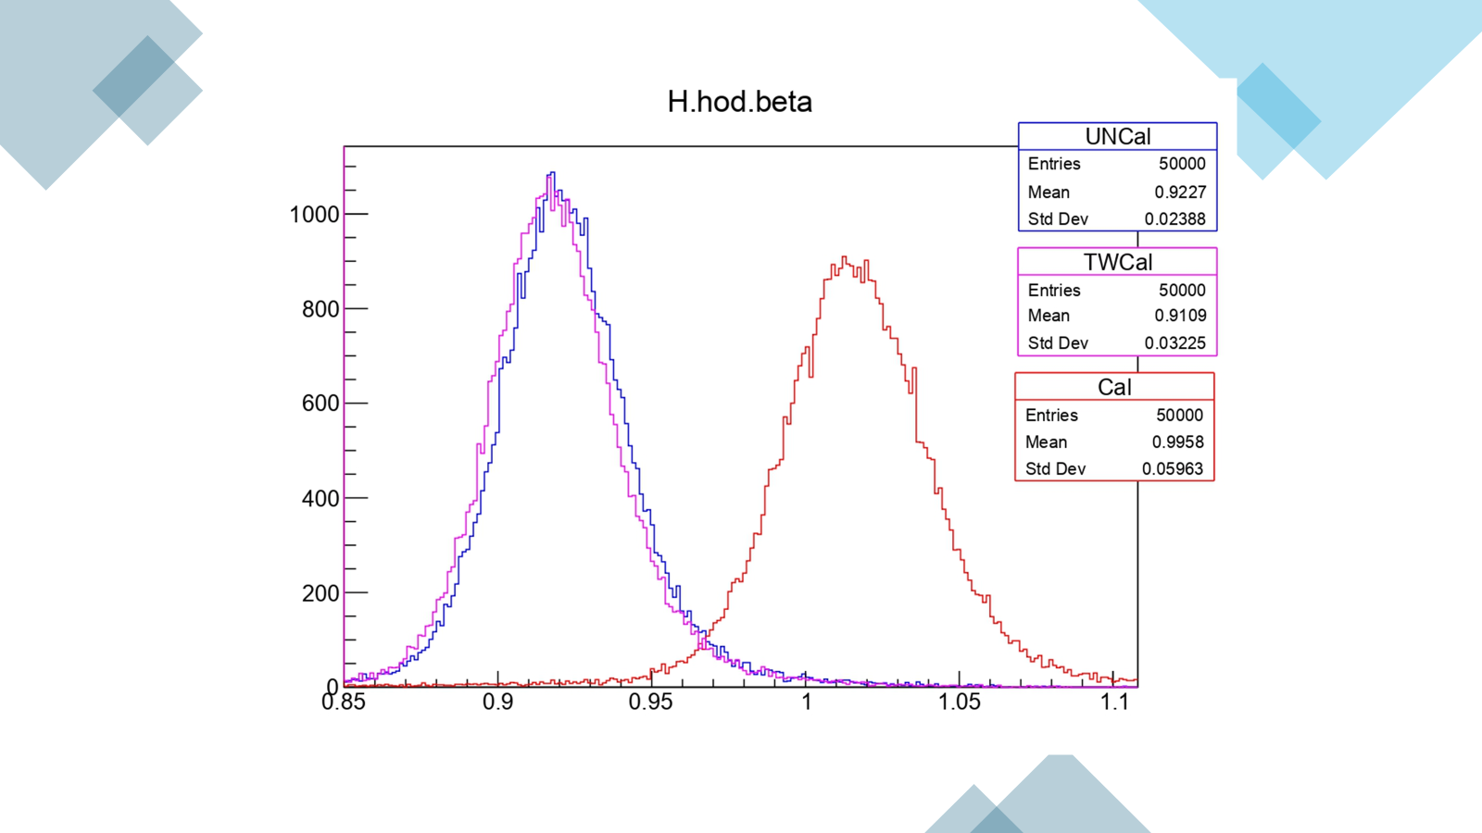

Slide 2
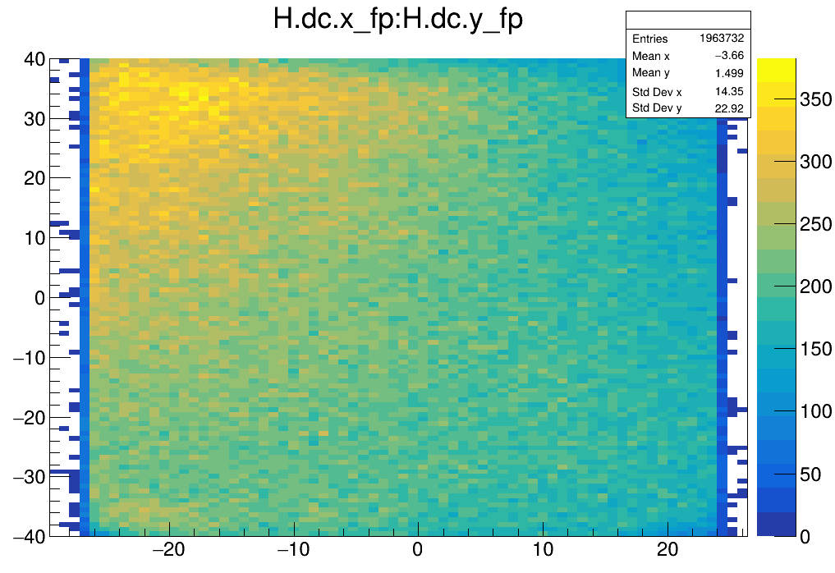
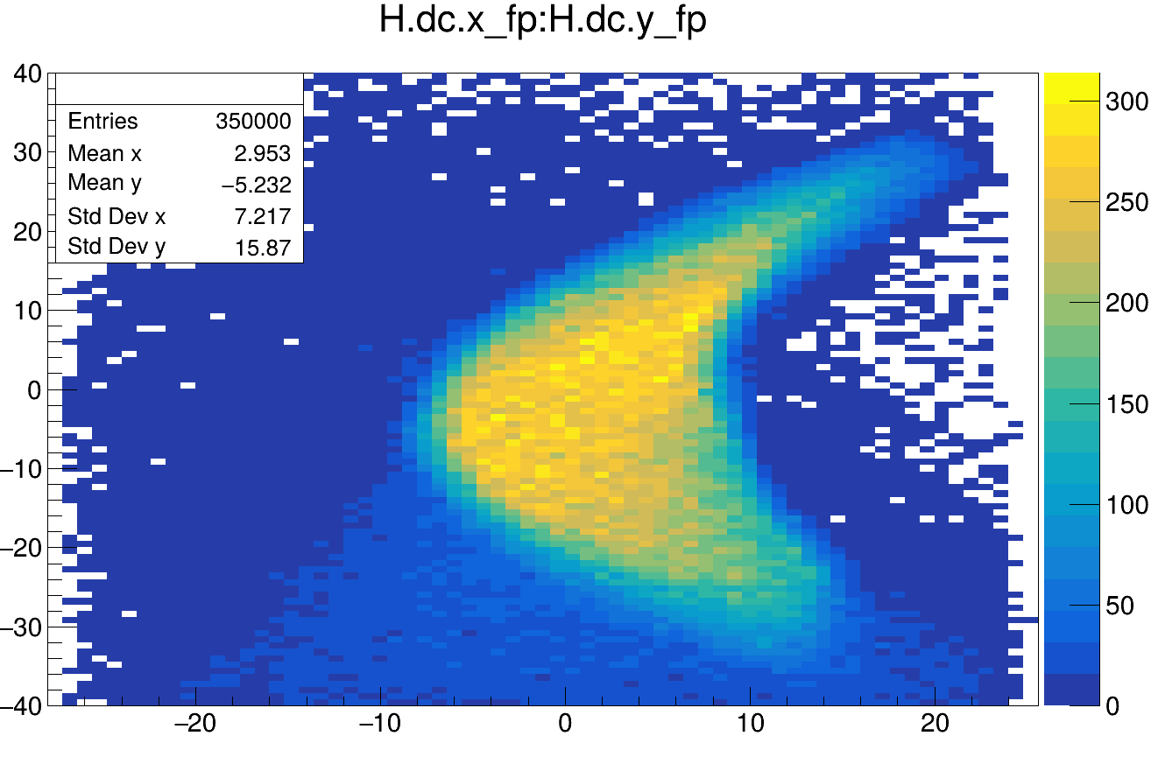
Defocused
Focused

Slide 3
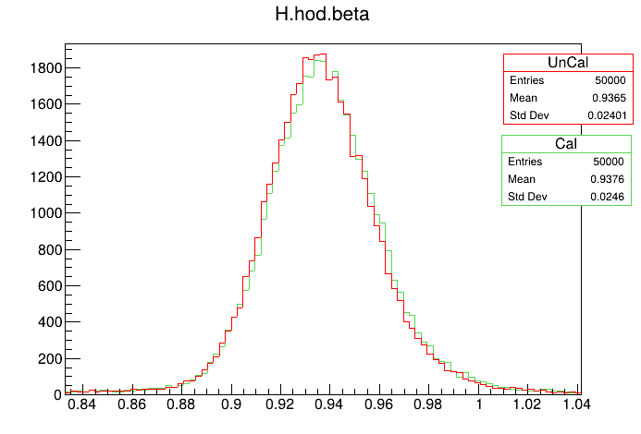
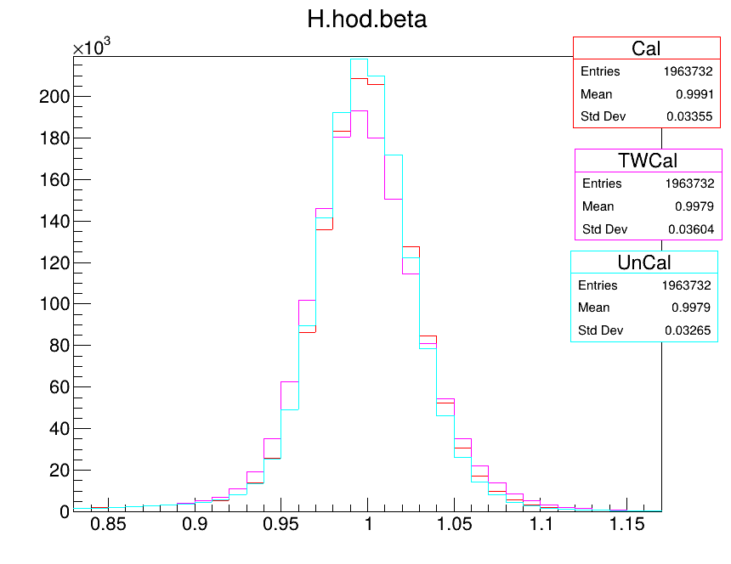
The comparison for before and after calibration for the hydrogen coincidence
The comparison for the defocused run before and after calibration

Slide 4
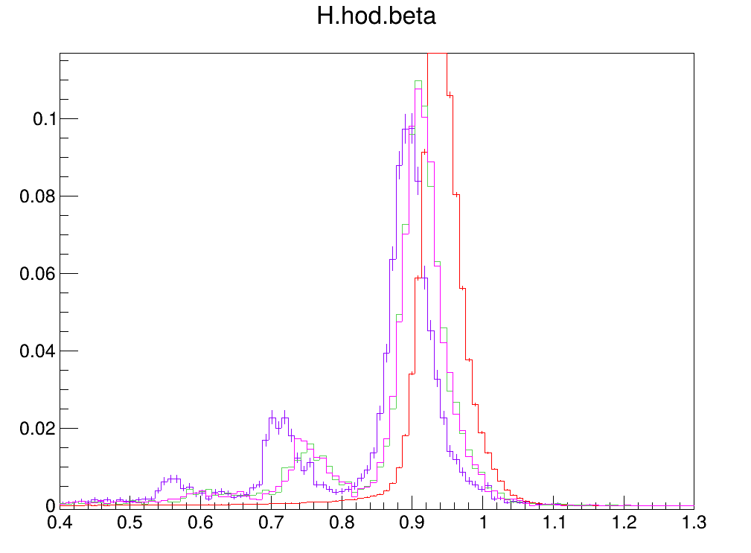
Deuteron Coincidence reactions
after calibration

Slide 5
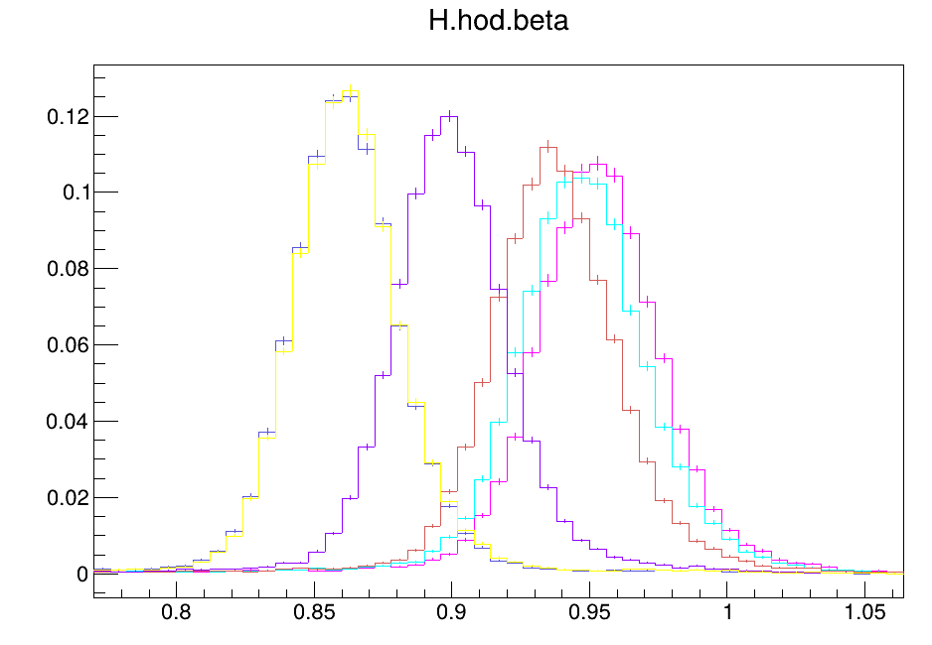
Hydrogen Coincidence Reaction after calibration

Slide 6
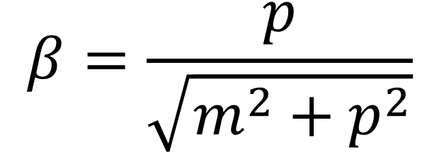
How do we check that these graphs are correct?
$$β=\frac{p}{\sqrt{m^{2}+p^{2}}}$$

